Slide 1
Example from textbook:
Rules at Statistics Netherlands for microdata protection
27.Nov 2025

Slide 2
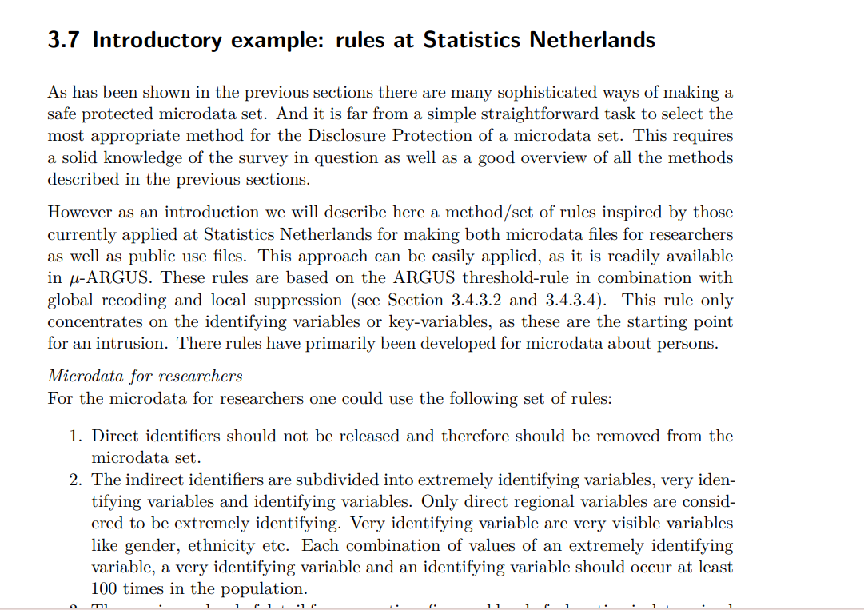
Content
Handbook on Statistical Disclosure Control https://sdctools.github.io/HandbookSDC/Handbook-on-Statistical-Disclosure-Control.pdf

Slide 3
Rules for microdata protection at
Statistics Netherlands
Easy applicable rules to avoid re-identification
Concentrates on the identifying variables (key-variables)
Based on the “ARGUS threshold-rule”:
  Avoid population-uniques AND individuals with keys that are rare in the population
  Keys = a combination of identifying variables
The rules are primarily for microdata about persons
Notes:
It concentrates on the identifying variables or key-variables, as these are the starting point for an intrusion.

Slide 4
Rules for microdata protection at
Statistics Netherlands
  Microdata for researchers (scientific use file - SUF)
    6 rules
  Microdata for the general public (public use file - PUF)
    PUFs need more protection than SUFs
    10 rules
    Higher thresholds

Slide 5
6 rules for protecting microdata for researchers

Slide 6
Microdata for researchers I
Remove direct identifiers (ex: name, e-mail, address…)
Divide indirect identifiers into:
  Extremely identifying variables
  Very identifying variables
  Identifying variables
Direct regional variables
Ex: name of region, municipality, city etc.
Very visible variables
Ex: gender, ethnicity etc.
Ex: Education, Occupation, etc

Slide 7
Microdata for researchers I
Remove direct identifiers (ex: name, e-mail, address…)
Divide indirect identifiers into:
  Extremely identifying variables
  Very identifying variables
  Identifying variables
For every combination of
Extremely identifying
Very identifying
Identifying
... there should be at least 100 occurrences in the population (F_{k} = 100)

Slide 8
Microdata for researchers II
The maximum level of detail for occupation, firm and level of education is determined by the most detailed direct regional variable.
Ex:
Geographical variable
County
Occupation
Municipality
Firm
City
Education
Notes:
This rule does not replace rule 2, but is instead a practical extension of that rule.

Slide 9
Microdata for researchers III
A region that can be distinguished in the microdata should contain at least 10 000 inhabitants.
For panel data: Direct regional variables should not be released
  Reason: panel data is more identifying
Notes:
This rule does not replace rule 2, but is instead a practical extension of that rule.
Panel data: If the microdata concern panel data direct regional data should not be released. This rule prevents the disclosure of individual information by using the panel character of the microdata.

Slide 10
Methods applied if rules are violated…
Important to find a balance to reduce loss of information
Method | Information loss
1) Global recoding | Less detail
2) Suppression | No information

Slide 11
Note: the rules are for person data!
They are not appropriate for business data
Business data have more skewed distributions
In general, it is very hard to make safe business microdata

Slide 12
Thank you!

